Slide 1
TOEIC 250 UNIT 12

Slide 2
CONTENTS: 1. Listening: Part 3 2. Vocabulary
Listening
Vocabulary
Short
Airlines
conversations
(1)

Slide 3
1
Listening

Slide 4
In part 3 TOEIC, candidates listen to conversations and answer three questions about each of conversations.

Slide 5
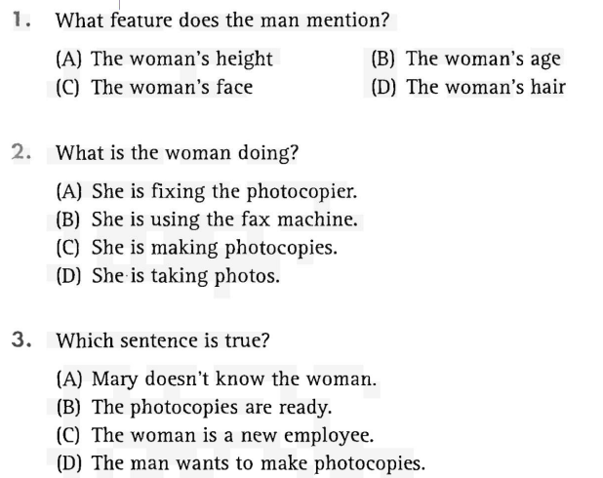
1. Track 17: Choose the best answer:

Slide 6
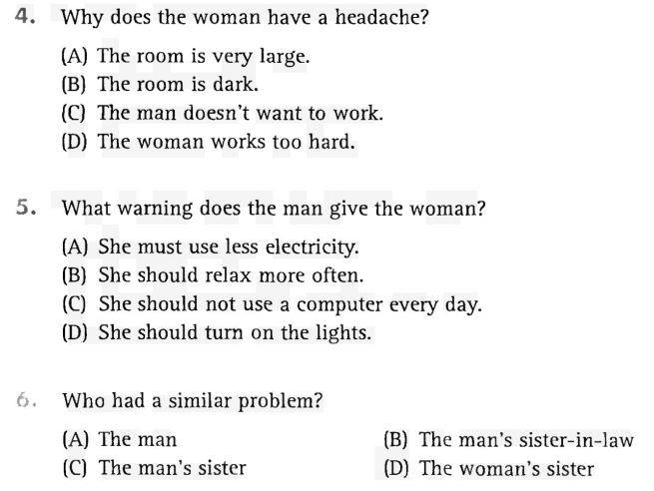
1. Track 17: Choose the best answer (cont):

Slide 7
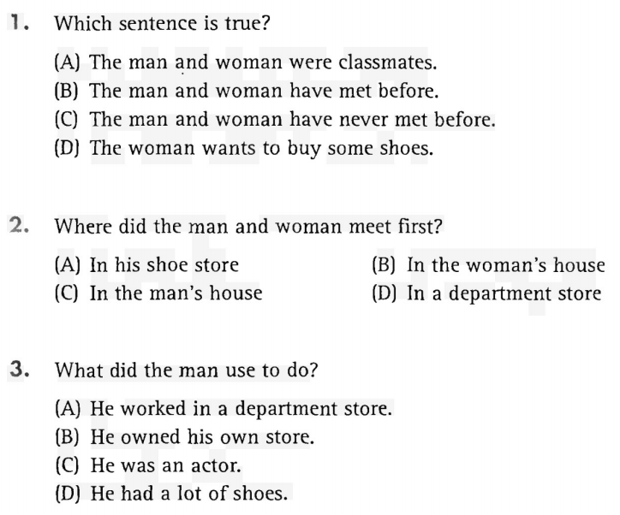
1. Track 18: Choose the best answer:

Slide 8
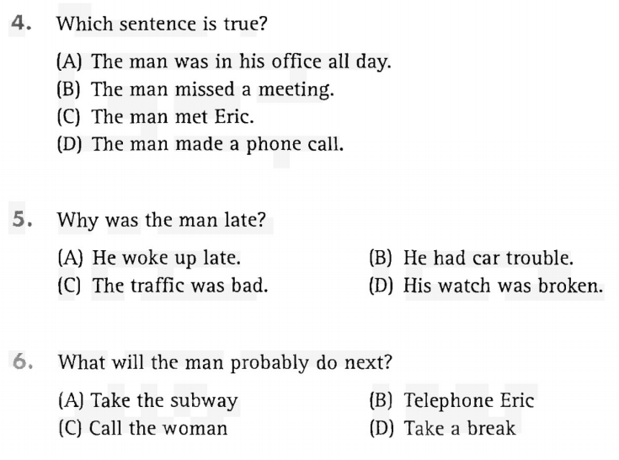
1. Track 18: Choose the best answer (cont):

Slide 9
VOCABULARY
AIRLINES

Slide 10

deal with
/diːl/
/wɪθ/
V. phrase, to attend to; to manage; to see to
a. Ticket agents must deal courteously with irate customers.
b. Sick passengers, frightened children, and rude pilots are just a few of the things cabin attendants have to deal with.

Slide 11
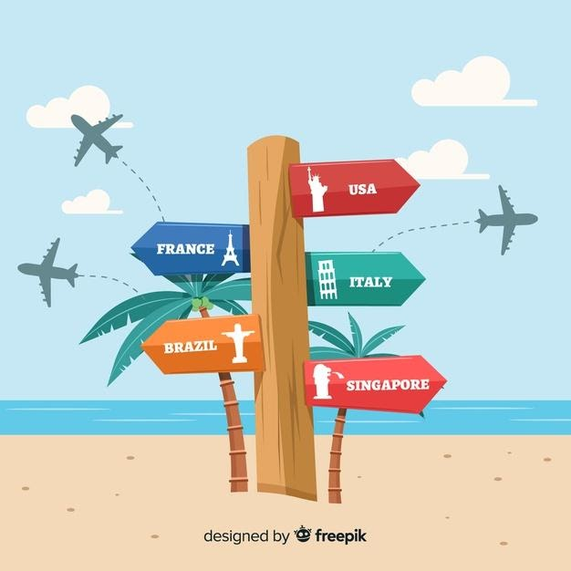
destination
/ˌdestɪˈneɪʃn/
N., the place to which one is going or directed
a. The Great Barrier Reef is a popular tourist destination this year.
b. Once you have determined your desired destination, we can work toward getting the best airfare.

Slide 12
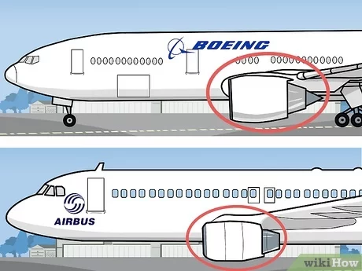
distinguish
/dɪˈstɪŋɡwɪʃ/
v., to make noticeable or different
a. Suki was able to distinguish between the different types of jets on the runway.
b. My travel agent has distinguished herself as being one of the best in our area.

Slide 13

economize
ɪˈkɒnəmaɪz/
V., to be careful about spending money
a. My travel agent knows I like to economize and always looks out for the best prices for me.
b. We decided to economize this year and take our vacation during the off season, when prices are lower.

Slide 14

equivalent
/ɪˈkwɪvələnt/
adj., equal
a. Carlos used the Internet to search for hotels of equivalent dollar value to the one recommended.
b. The food the airline serves in coach class is equivalent to that served in
first class.

Slide 15

excursion
/ɪkˈskɜːʃn/
N., a pleasure trip; a trip at a reduced fare
a. With some time between meetings in London, the company president enjoyed an excursion to Stonehenge.
b. The finance officer was pleased to find an excursion for the entire consulting team.

Slide 16
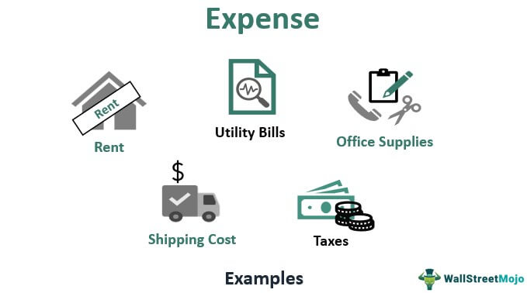
expense
/ɪkˈspens/
n., something requiring payment
a. A luxury vacation involves many expenses.
b. If we keep our expenses down, we might have enough money to take a longer trip.

Slide 17

extend
/ɪkˈstend/
v., to make longer; to offer
a. We extended our vacation by a day.
b. Our wonderful travel agent extended the full services of her firm to us.

Slide 18

prospective
/prəˈspektɪv/
adj., likely to become or be
a. The airline had a reception to impress travel agents who might be prospective clients.
b. I narrowed my list of prospective destinations to my three top choices.

Slide 19

situation
/ˌsɪtʃuˈeɪʃn/
n., the combination of circumstances at a given moment
a. The airline suggested I check with the State Department regarding the political situation in the country I'm flying to.
b. The vast number of different airfares available makes for a complicated situation.

Slide 20
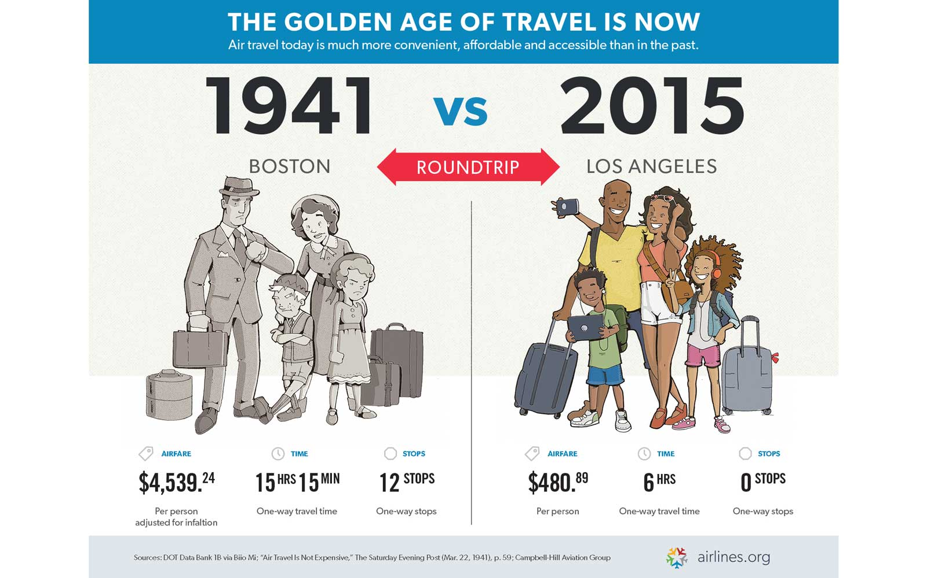
substantially
/səbˈstænʃəli/
adj., significantly
a. The airline I work for had a substantially higher rating for customer satisfaction than our competitors had.
b. The airfares charged by different airlines are not substantially different.

Slide 21

system
/ˈsɪstəm/
n., a functionally related group of elements
a. The airline system covers the entire world with flights.
b. We need a better system to keep track of how much money we are spending on this vacation.

Slide 22
